Slide 1

Mody University of Science and Technology
College of Engineering and Technology
Department of Computer Science and Engineering
Major Project Presentation On
“ TWITTER SENTIMENT ANALYSIS”
UNDER THE GUIDANCE OF
DR. AJAY KUMAR SINGH
Presented By :
Rushali Verma(130275)
Komal Mehta (130192)
B.TECH( IVth Yr.)
CSE

Slide 2
CONTENTS
OBJECTIVE
INTRODUCTION TO TWITTER
INTRODUCTION TO R LANGUAGE
HOW TO ANALYZE THE SENTIMENTS IN R ?
BASIC STEPS TO ANALYZE THE SENTIMENTS IN R
TWITTER SENTIMENT ANALYSIS USING R
TOOLS AND PACKAGES USED
SNAPSHOTS OF THE PROJECT DONE TILL NOW
CONCLUSION

Slide 3
OBJECTIVE
This project addresses the problem of sentiment analysis in twitter; that is classifying tweets according to the sentiment expressed in them: positive, negative or neutral.
Analysing the public sentiment is important for many applications such as firms trying to find out the response of their products in the market, predicting political elections and predicting socioeconomic phenomena like stock exchange.
The aim of this project is to develop a functional classifier for accurate and automatic sentiment classification of an unknown tweet stream.

Slide 4

INTRODUCTION TO “TWITTER”
Twitter is an amazing micro blogging tool and an extraordinary communication medium.
In addition, Twitter can also be an amazing open mine for text and social web analyses. Among the different software that can be used to analyze twitter, R offers a wide variety of options to do lots of interesting and fun things.
Twitter is an online news and social networking service where users post and interact with messages, "tweets," restricted to 140 characters. Registered users can post tweets, but those who are unregistered can only read them.

Slide 5

INTRODUCTION TO “R LANGUAGE”
R is a programming language and software environment for statistical analysis, graphics representation and reporting.
R was created by Ross Ihaka and Robert Gentleman at the University of Auckland, New Zealand, and is currently developed by the R Development Core Team.
R is a well-developed, simple and effective programming language which includes conditionals, loops, user defined recursive functions and input and output facilities.
R has an effective data handling and storage facility,
R provides a suite of operators for calculations on arrays, lists, vectors and matrices.
R provides a large, coherent and integrated collection of tools for data analysis.

Slide 6
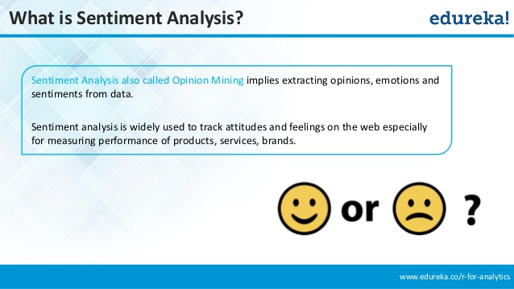
BASIC STEPS TO APPLY SENTIMENT ANALYSIS IN R
LOAD THE DATA.
CREATE A LIST OF POSITIVE WORDS.
CREATE A LIST OF NEGATIVE WORDS.
APPLY THE SENTIMENT ALGORITHM.
ANALYZE THE RESULT VIA FREQUENCY DISTRIBUTION, MEAN, MEDIAN, HISTOGRAM ETC.

Slide 7
TWITTER SENTIMENTS ANALYSIS USING “R”
ABOUT THE PROJECT :
It is about analyzing the mood on Twitter about a certain Keyword.
You get a number of tweets which contain a keyword you can define, filter out the text of these tweets and then see if there are more positive or negative words.
In this project “Twitter Analysis using R” , we have performed the Sentiment Analysis and Text Mining techniques.
This project is done in RStudio which uses the libraries of R programming languages.

Slide 8
TOOLS AND PACKAGES USED
In this project “Twitter Sentiments Analysis using R” , we have used RStudio GUI and following packages:
twitteR : Provides an interface to the Twitter web API.
ROAuth : This package provides an interface to the OAuth 1.0 specification, allowing users to authenticate via OAuth to the server of their choice.
plyr : This package is a set of tools that solves a common set of problems: you need to break a big problem down into manageable pieces, operate on each pieces and then put all the pieces back together.
stringr : stringr is a set of simple wrappers that make R's string functions more consistent, simpler and easier to use. It does this by ensuring that: function and argument names (and positions) are consistent, all functions deal with NA's and zero length character appropriately, and the output data structures from each function matches the input data structures of other functions.
ggplot2 : An implementation of the grammar of graphics in R. It combines the advantages of both base and lattice graphics: conditioning and shared axes are handled automatically, and you can still build up a plot step by step from multiple data sources.

Slide 9
SNAPSHOTS OF THE WORK DONE TILL NOW
CREATING A TWITTER APPLICATION
First step to perform Twitter Analysis is to create a twitter application. This application will allow you to perform analysis by connecting your R console to the twitter using the Twitter API. The steps for creating your twitter applications are:
Go to https://dev.twitter.com and login by using your twitter account.
Then go to My Applications → Create a new application.
Give your application a name, describe about your application in few words, provide your website’s URL or your blog address (in case you don’t have any website). Leave the Callback URL blank for now. Complete other formalities and create your twitter application. Once, all the steps are done, the created application will show as below. Please note the Consumer key and Consumer Secret numbers as they will be used in RStudio later.

Slide 10
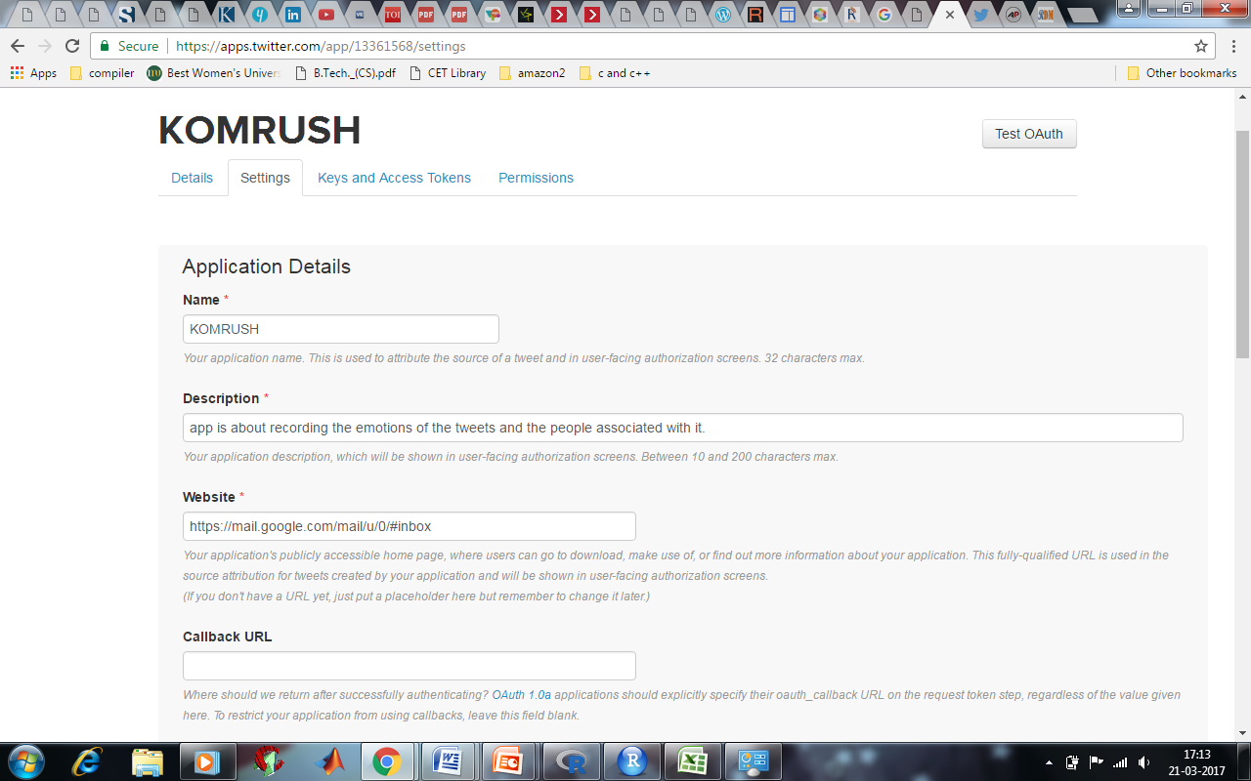

Slide 11
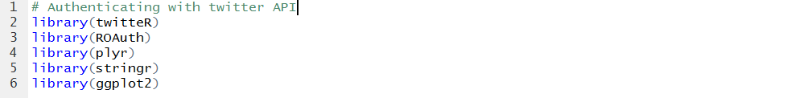
WORKING ON RStudio
In this section, we will first use some packages in R.
These are twitter, ROAuth, plyr, stringr and ggplot2.
You can install these packages by the following commands:
Now run the following R script code snippet

Slide 12
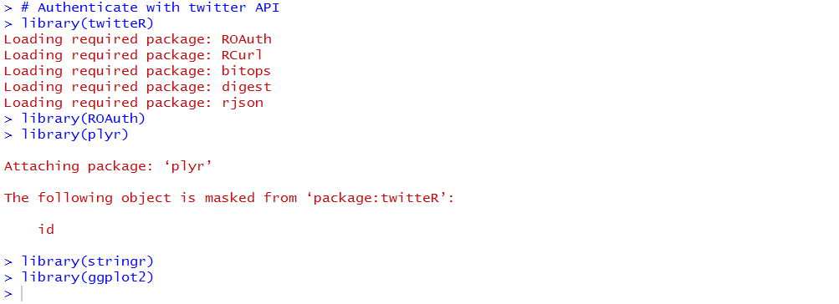
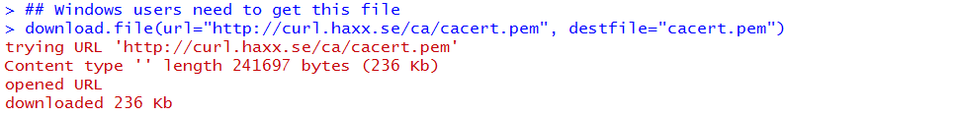
After running this script section, the console will look like this
Now, windows users need to download a small file by following command

Slide 13
After running this code, RStudio will look for the following file at the given url, and will download it for you. Your console will look like this:

Slide 14
Now once this file is downloaded, we are now moving on to accessing the twitter API. This step include the script code to perform handshake using the Consumer Key and Consumer Secret number of your own application. You have to change these entries by the keys from your application. Following is the code you have to run to perform handshake.
> reqURL <- 'https://api.twitter.com/oauth/request_token'
> accessURL <- 'https://api.twitter.com/oauth/access_token'
> authURL <- 'https://api.twitter.com/oauth/authorize'
>consumerSecret= 'Ex8c2yZMhbJHNHRe4sOlW5OmcbXJtf3eTEaw8Ko3PCrk09skQN'
> consumerKey <- 'zkTOcr8n8YXQVTElHxMN0993l'
> Cred <- OAuthFactory$new(consumerKey=consumerKey,
+ consumerSecret=consumerSecret,
+ requestURL=reqURL,
+ accessURL=accessURL,
+ authURL=authURL)
Here, we assign the request url, access url and authorization url of twitter application to the variables requestURL, accessURL and authURL respectively.
consumerKey and consumerSecret are unique to a twitter applicartion.

Slide 15
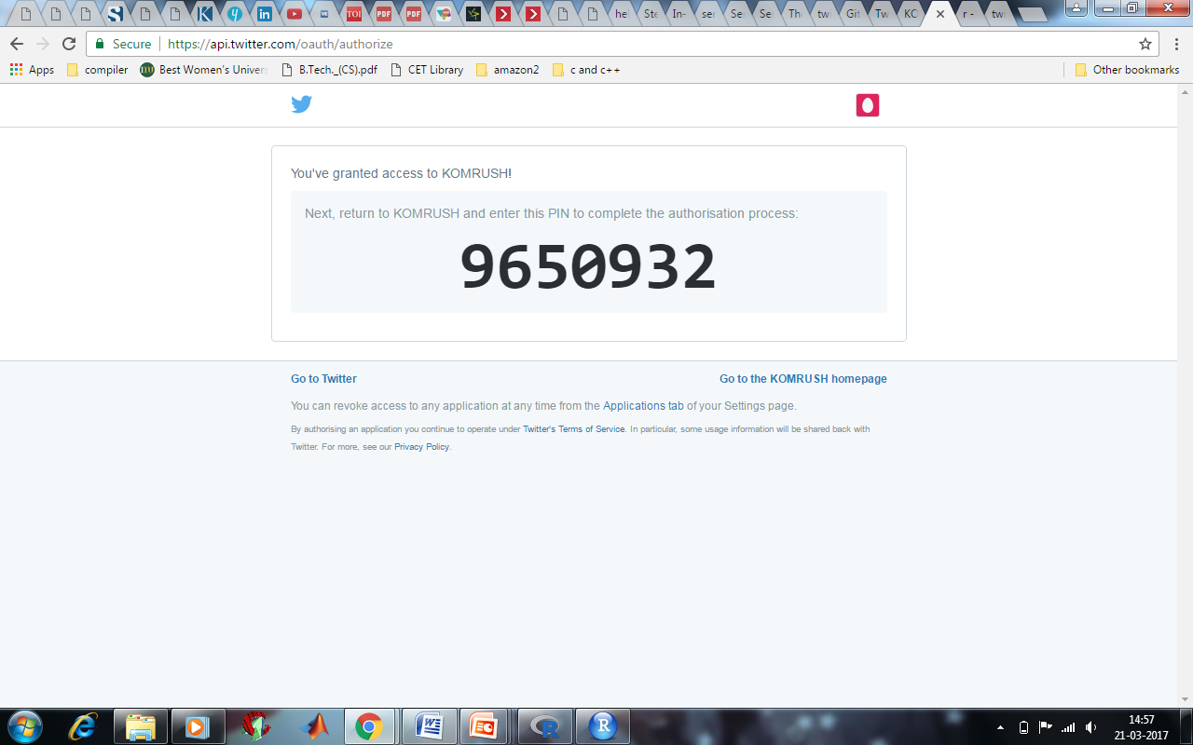
AUTHORIZATION WITH THE APPLICATION THROUGH A PIN
To enable the connection, please direct your web browser to: “https://api.twitter.com/oauth/authorize?oauth_token=iJ2EaAAAAAAAy-GgAAABWvAp9No “
When complete, record the PIN given to you and provide it here: 9650932
> save(Cred, file='twitter authentication.Rdata') > load('twitter authentication.Rdata') > registerTwitterOAuth(Cred)

Slide 16
REGISTRATION OF THE AUTHORIZED APPLICATION
> access_token = '825991813710241793-tJH84eqWPCdIOzGM7mxEtoHaYfv1zRU'
> access_token_secret = 'IJjQvGqGYvzap4fpPEnEFcANsV0FIgVzjjj4jewB1W2dh'
> api_key='zkTOcr8n8YXQVTElHxMN0993l'
> api_secret='Ex8c2yZMhbJHNHRe4sOlW5OmcbXJtf3eTEaw8Ko3PCrk09skQN'
> setup_twitter_oauth(api_key,api_secret,access_token,
+ access_token_secret)
[1] "Using direct authentication"
1: Yes
2: No
Selection: 1

Slide 17
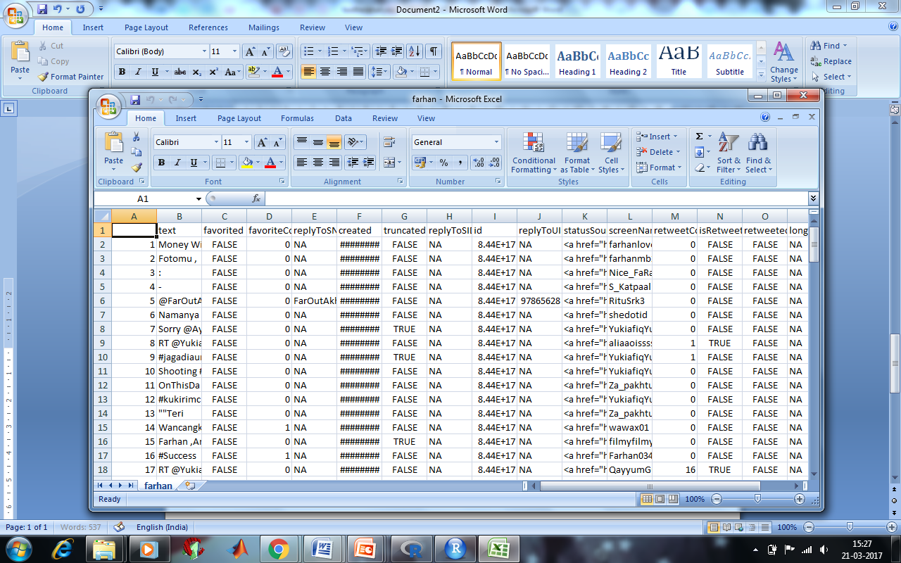
Once the handshake is done and authorized by twitter, we can fetch most recent tweets related to any keyword. The code for getting tweets related to #farhanakhtar:

Slide 18
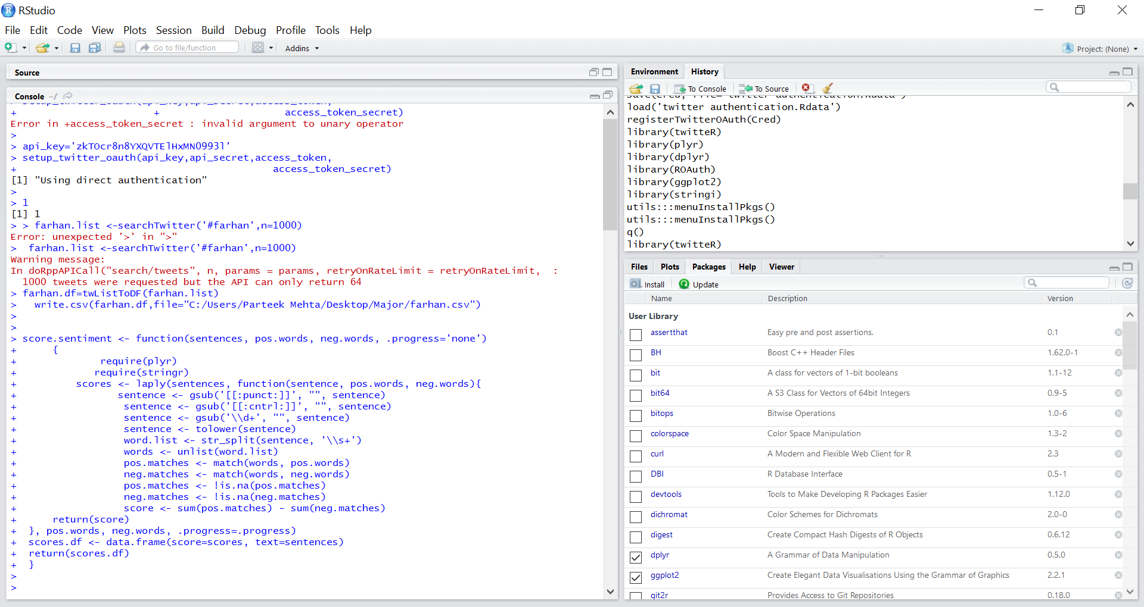
CODE FOR SENTIMENT ANALYSIS

Slide 19
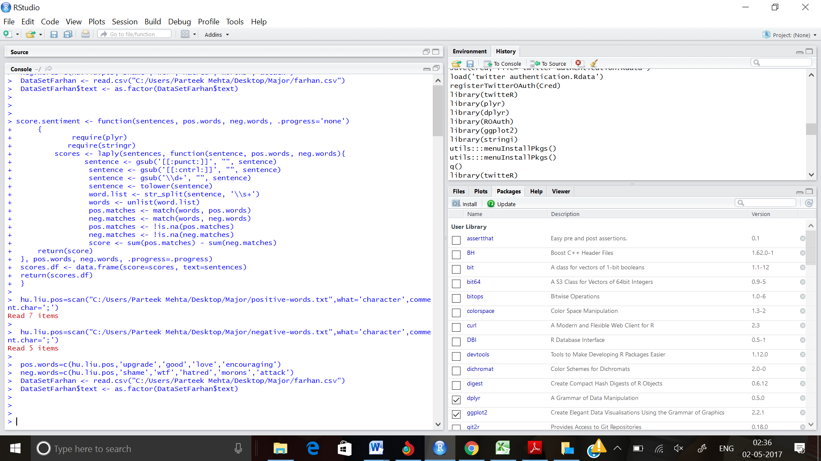
CODE FOR NEGATIVE AND POSTIVE TWEETS

Slide 20
The sentiment function calculates score for each individual tweet. It first calculate the positive score by comparing words with the negative words list and then calculate negative score by comparing words with negative words list. The final score is calculated as
Score = positive score – negative score.
The main working principle of sentiment analysis is to find the words in the tweets that represent positive sentiments and find the words in the tweets that represent negative sentiments.
For this a list of words that contains positive and negative sentiment words was needed.
A list of positive and negative words complied which was publicly available was downloaded from Twitter. After downloading the list, it was saved it in a working directory. The sentiment analysis uses two packages plyr and stringr to manipulate strings.

Slide 21
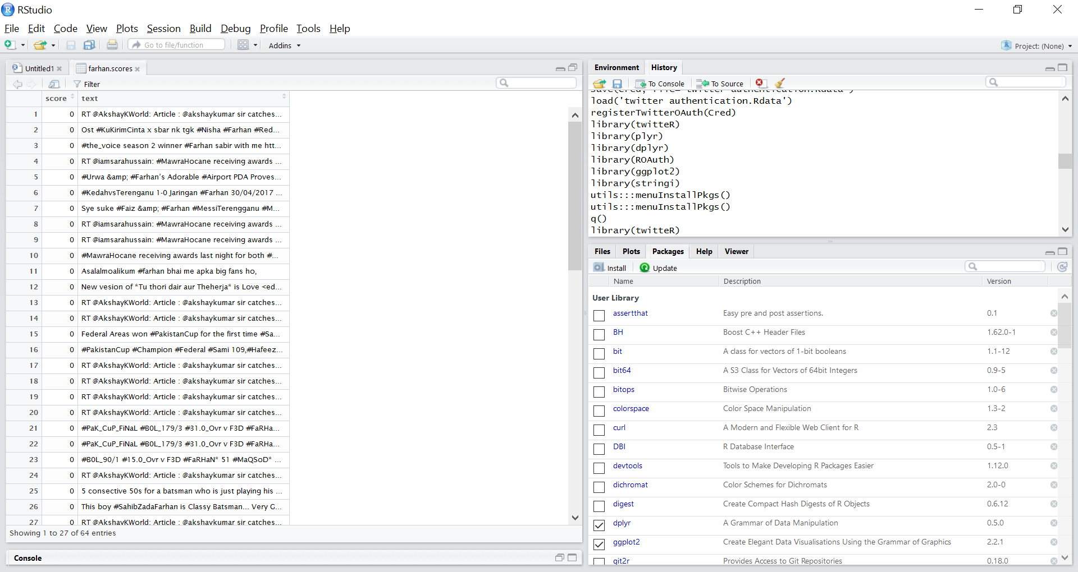
CODE FOR VIEWING THE FARHAN SCORES

Slide 22
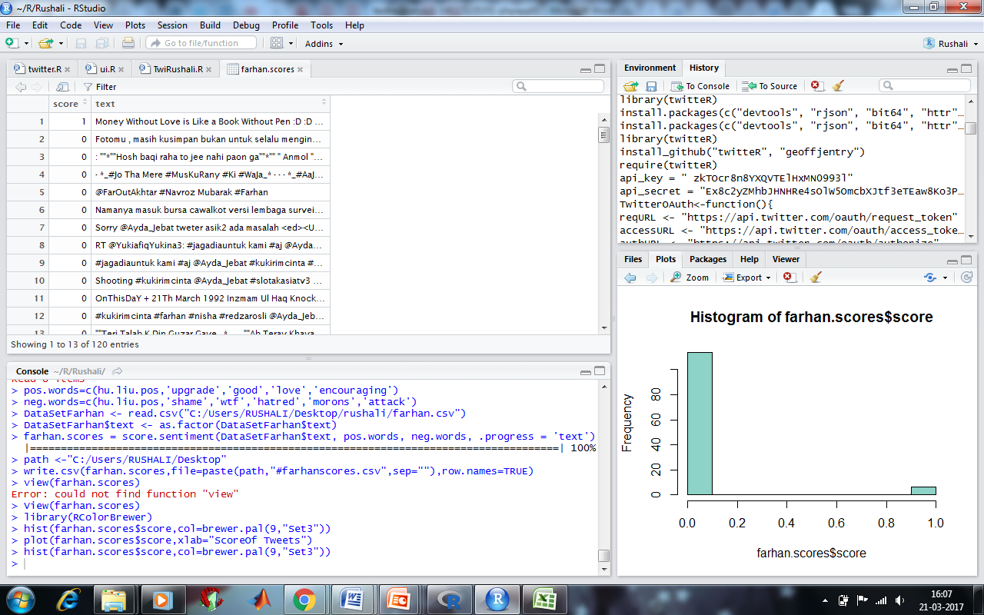
HISTOGRAM OF FARHAN$SCORES
Finally a histogram was constructed to present a better scenario of our analysis. As we can see the red area is depicting the people having positive opinion about the topic, Green depicts the negative opinion and blue depicts the positive opinion.

Slide 23
CONCLUSION
A hybrid of knowledge based methodologies and machine learning methodologies were used in order to give a thorough examination of the tweets of #FarhanAkhtar which were extracted from Twitter.
#FarhanAkhtar did not produce very many tweets therefore the concentration of the project fell to the tweets pulled from #FarhanAkhtar, which returned 120 tweets.
The extraction of tweets from twitter proved to be more difficult than expected and several attempts were made to produce a dataset.

Slide 24


